Slide 1
A DIVISION OF WELLSPARK
Health Enhancement Program
(HEP)

Slide 2
How HEP Works
All requirements and chronic condition education are measured per calendar year
Preventive requirements are determined by age and gender
Chronic conditions are determined through claims and medication history on an individual basis
All requirements (preventive and chronic education) are to be completed by December 31 of each year
If you have joined HEP at any time after January 1st of the current year, you will have until the end of the following year to complete your requirements
2
Confidential and Proprietary Do Not Distribute

Slide 3
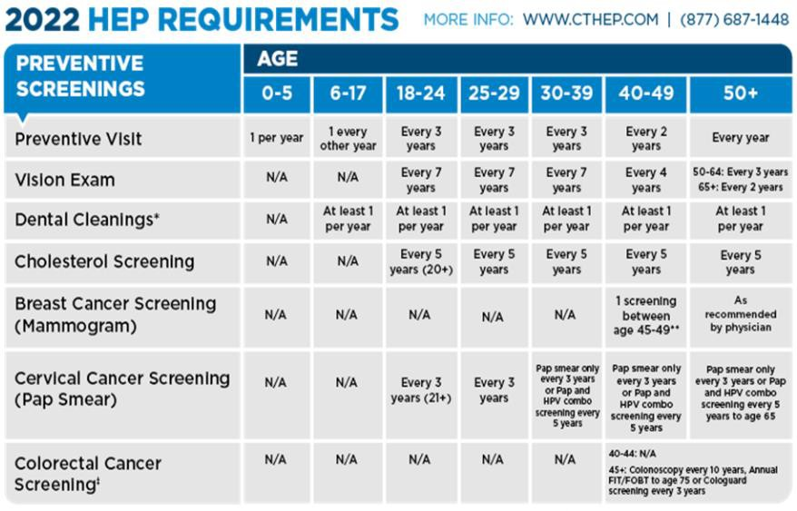

Preventive Requirements
3
Confidential and Proprietary Do Not Distribute

Slide 4

Chronic Condition Education and Counseling
The HEP program requires participants who have been identified with one or more of the following chronic conditions to complete annual educational requirements related to their disease, as well as accept a call from a CMSI registered nurse if one should reach out:
Diabetes (Type 1 or 2)
Asthma
COPD
Heart Disease/Heart Failure
Hyperlipidemia
Hypertension
All educational materials can be found at CTHEP.com
4
Confidential and Proprietary Do Not Distribute

Slide 5

Benefits of HEP
HEP benefits your health while rewarding employees and their dependents with a number of financial benefits by remaining compliant with the program:
Lower premium payments – Non-HEP employees pay an additional $100 per month in premium
Lower out-of-pocket expenses – Non-HEP employees pay annual $350 individual/$1,400 family in-network medical deductible
Lower out-of-pocket expenses – Non-HEP employees pay annual $350 individual/$1,400 family in-network medical deductible
Office visit co-pays are waived for anything related to the chronic conditions
Lower to $0 co-pays for medications used to treat any of the chronic conditions mentioned earlier
5
Confidential and Proprietary Do Not Distribute

Slide 6
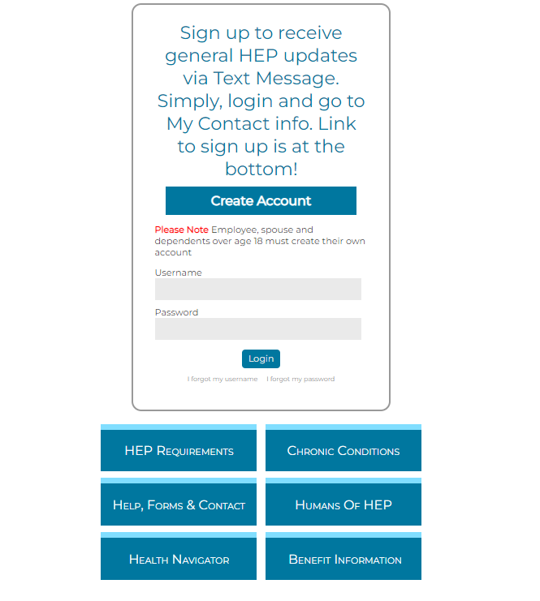
Register Online
Online portal access will be available approximately two months after your effective date
You can access information using the links below the login screen before you register
Register at CTHEP.com
6
Confidential and Proprietary Do Not Distribute

Slide 7
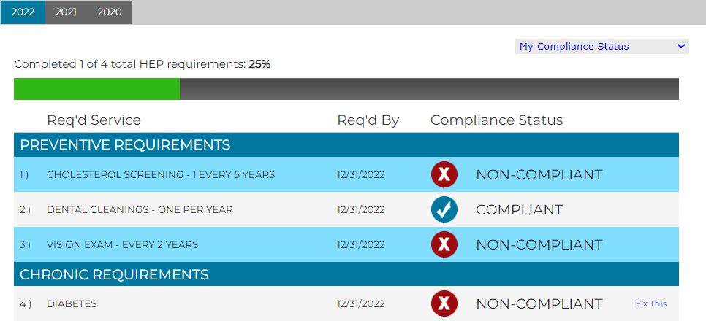
View Your Personal Requirements via the Web Portal
Once registered, you can:
Check your compliance status
Click on the “My Compliance Status” drop-down to check your family status
If identified with a chronic condition, click “fix this” to take a 5-question survey or read a fact sheet to complete the requirement online
7
Confidential and Proprietary Do Not Distribute

Slide 8

We are here when you need us…
Contact our call center to receive guided support at 1.877.687.1448
Monday-Thursday 8am – 6pm and Friday 8am – 5pm
You can also contact a customer service representative via email at HEPQuestions@Connect2YourHealth.com.
Fax number: 855-207-1640
You can log onto CTHEP.com and register 60 days from your insurance effective date
Notes:
We are here for you whenever you need us so please don’t hesitant to reach out. You can contact Andrew or Nicole to get started with our Diabetes Prevention Program or our dedicated diabetes line for our diabetes education. To get signed up for our diabetes education program please make sure to leave a message with your full name and best call back number.

Slide 9

Thank you
Live Q & A

