Slide 1

2022 Dental Plan Options
State of Connecticut
Notes:
Welcome to our presentation where we’ll be providing information about your dental plan options for the 2022 plan year.

Slide 2

State of Connecticut 2022 Plan Options
Four plans to choose from that include:
Routine preventive care services
Cleanings
Exams
Routine x-rays
Fillings
Periodontal care
Root canals
Crowns
Oral surgery
Cigna Dental Virtual Care
Cigna Dental Oral Health Integration Program®
Notes:
This year you once again have four different plans to choose from. Each plan has different levels of coverage and out-of-pocket costs, but they all cover common types of care, such as the examples included on screen. All plan options also cover services through Cigna Dental Virtual Care which is available on your myCigna account. And all Cigna dental customers with one of 14 medical conditions such as diabetes, heart disease, pregnancy and more are eligible to enroll in the Cigna Dental Oral Health Integration Program. This program reimburses enrolled customers for certain covered dental services that may help manage certain medical conditions. You can get more information about which medical conditions are covered by visiting the State of Connecticut enrollment site at Cigna.com/stateofct

Slide 3
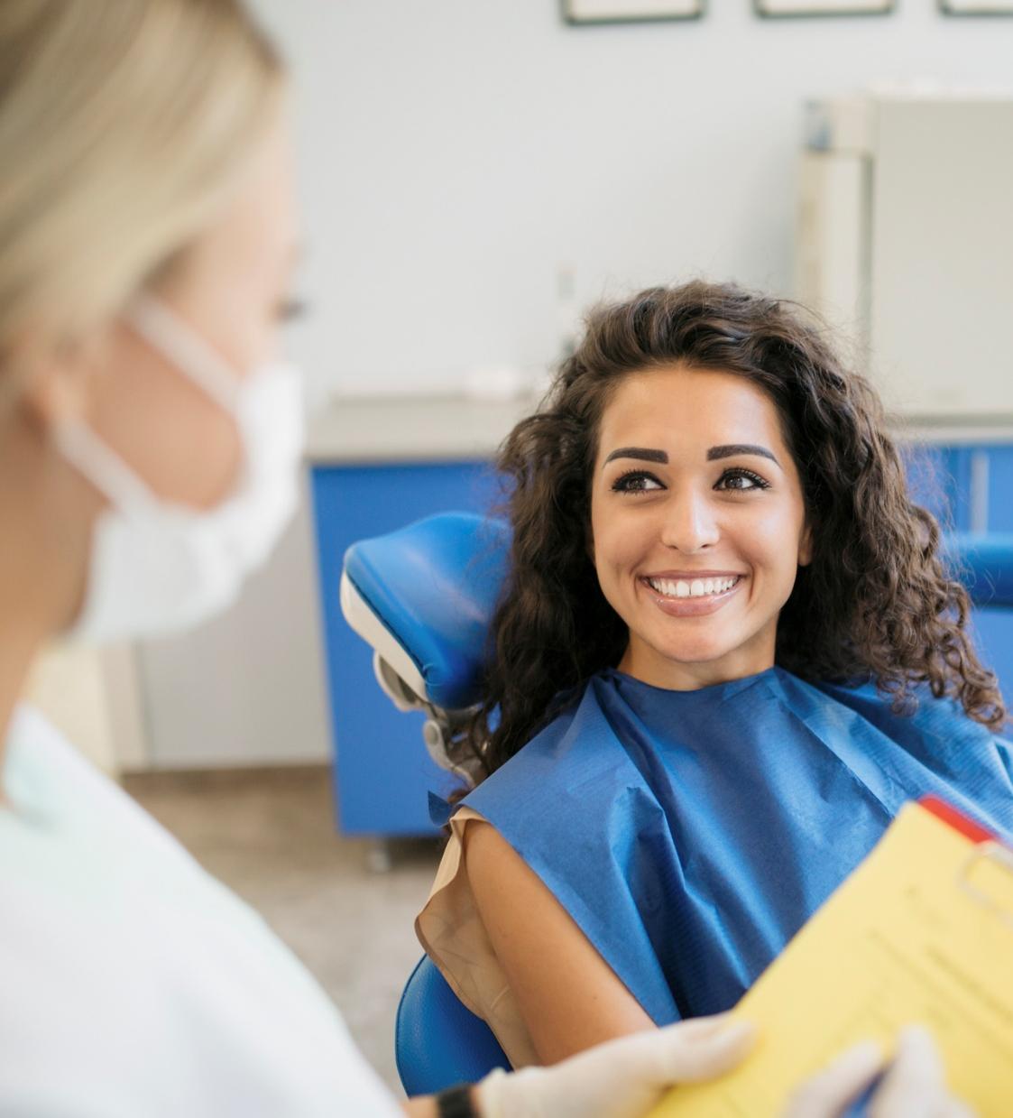
State of Connecticut 2022 Plan Update
Plan update
Effective July 1, 2022, the dependent age limit will increase to 26 years of age.
Previously, the age limit was 19 years.
If you have dependents under the age of 26, you can enroll them on your plan.
Like your medical and pharmacy plan rules, dental coverage ends at the end of the calendar year in which the dependent turns age 26.
For example: Dependent turns 26 in October 2022. Their coverage would end on December 31, 2022.
Notes:
Before we jump into the plan overviews, there is one important update that affects all of your plan options. Effective July 1, 2022, the dependent age limit will change to 26 years of age. The current age limit is 19. This means if you have dependents age 26 or younger, they can be enrolled on your plan. Dental coverage ends at the end of the calendar year in which the dependent turns age 26. If your dependent turns 26 in October, their coverage would end on December 31, even though your plan year goes through June 30th of the next year. This is just like your medical and pharmacy dependent age coverage.

Slide 4
THINGS TO CONSIDER
Most major service types like orthodontia, dentures and implants are not covered.
Dentists
Although you can use any dentist, you’ll save by using a dentist in the plan network because they have agreed to reduce fees for Cigna customers.
Basic Plan
No annual deductible and no annual dollar maximum.
Your costs are based on a coinsurance. This means you pay a percentage of the allowed cost for covered that service.
Final costs can vary depending on which dentist you use. You’ll save by using a network dentist because they have agreed to reduce their fees for Cigna customers. For example:
Dentist A Dentist B Dentist C
$100 $125 $150
20% coinsurance $20 $25 $30
Some types of services this plan DOES NOT COVER:
Dentures (repairs are covered) Implants
Orthodontics TMJ-related services*
Anesthesia (IV/General)*
*Your medical plan may cover this service. Contact your Health Navigator for more information.
4
Notes:
The basic plan has no annual deductible or annual dollar maximum on covered services. Your out-of-pocket costs are based on coinsurance. This means you pay a percentage of the allowed cost for covered services. Because dentists may charge different amounts for the same type of services, your final cost can vary depending on which dentist you use. You’ll save by using a network dentist because they have agreed to reduce their fees for Cigna customers.
Anesthesia is excluded under the Basic plan but may be considered under the State of Connecticut medical plan. Filing a pre-treatment estimate can help you understand what services will be covered and what your out-of-pocket costs will be. You can also contact a Health Navigator for assistance.
Here is an example of how your final costs can vary for the same service with different dentists. Let’s say the service you’re getting is covered at 80%, which means you pay 20%. You can see how, depending on what the dentist charges, your final costs may be different, as they are calculated based on a percentage of the fee charged.

Slide 5
THINGS TO CONSIDER
Orthodontia is covered but has a $1,500 lifetime maximum. You pay 100% of charges once maximum is met.
Example
Metal braces for 24 months $5,000
Plan pays 50% $1,500 up to $1,500
You pay $3,500
If you choose invisible aligners through your orthodontist, you are responsible for any additional fees.
Surgical implants are covered up to a $500 annual maximum. You pay 100% of charges once maximum is met.
Example
Endosteal implant $2,500
Play pays 50% $500 up to $500
You pay $2,000
Enhanced Plan
You must pay an annual deductible for certain services before the plan begins to pay for care.
There is an annual dollar maximum of $3,000 per person. Once you reach this maximum, you are responsible for paying 100% of the charges.
Your costs are based on coinsurance. This means you pay a percentage of the allowed cost for covered services.
Final costs can vary depending on which dentist you use. You’ll save by using a network dentist because they have agreed to reduce their fees for Cigna customers and cannot balance bill for the difference between their usual fees and the amount allowed by Cigna. For example:
In-network Out-of-network
Usual fee $150 $300
Allowed amount $100 $150
20% coinsurance $20 $30
Balance bill No Yes - $150
5
Notes:
The Enhanced plan has an annual deductible of $25 if enrolled as an individual or $75 if you’re enrolling any dependents. The plan also has an annual dollar maximum, which applies to most services – the only exceptions are for surgical implants which have a $500 annual max and orthodontics which have a $1,500 lifetime max. Once you reach any plan maximum, you’re responsible for paying 100% of the charges. Like the Basic Plan, your costs are based on coinsurance which is a percentage of the allowed cost for covered services. Because of this, your final costs can vary depending on which dentist you use. You’ll save by choosing a network dentist because they have agreed to reduce their fees for Cigna customers.
Additionally, network dentists cannot balance bill you. Balance billing happens when the amount Cigna allows for a covered service is less than what a dentist normally charges. Network dentists cannot balance bill you, but out-of-network dentists can. Here’s an example of how this works. The orange column represents and in-network dentist and the gray column and out-of-network dentist.. You can see what their usual fees are for this example, and the allowed amount. For network dentists, the allowed amount is the fee they have agreed to accept from Cigna customers. For out-of-network dentists, the allowed amount is based on the “maximum allowable charge”. This amount is determined by looking at what 90% of the dentists in your area charge for the same. You pay 20% of the allowed amount, and network dentists can’t charge you for the difference between their usual fee and the allowed amount. However, out-of-network dentists CAN charge you for the difference, which you can see here in this example.
There are some important things you need to know about this plan.
Orthodontics is covered at 50%, but only up to the lifetime maximum of $1,500. You pay the other 50% plus any amount over the max. If you choose to use invisible aligners, they must be provided by a local orthodontist who performs regular exams to monitor progress. The plan does not cover mail-order or similar types of care. Additionally, you’re responsible for the costs over and above what traditional metal braces cost. Here’s an example.
Surgical implants have a $500 annual maximum. That means once the plan has paid that amount, you’re responsible for all charges until the end of the plan year. Here’s an example.

Slide 6
THINGS TO CONSIDER
This is a network-only plan which means you must use a dentist in the plan network for care to be covered.
You can use Cigna Dental Virtual Care without a referral. There is no cost to consult with a dentist through this program.
Surgical implants are covered up to a maximum of one implant per year.
Orthodontia
You may use invisible aligners if your network orthodontist feels your case is appropriate. You are responsible for any costs above what the plan covers for traditional metal braces.
Total Care DHMO and Cigna Dental Care DHMO
No annual deductible and no annual dollar maximum.
Total Care DHMO – coinsurance (amount you pay is lower than Enhanced Plan)
Cigna Dental Care DHMO — copays.
Services must be performed by a dentist in the plan network.
You choose a network dentist to provide all primary care. When necessary, your dentist will refer you to specialists.
Plans include coverage for
Teeth whitening Custom-fabricated athletic mouth guards
Fluoride all ages Sealants all ages and all teeth
TMJ-related services Orthodontia with no dollar maximum
Implants with no dollar maximum (limit of one implant per year)
Notes:
The Total Care DHMO and Cigna Dental Care DHMO have some features that may reduce your costs for a variety of services, including some not covered by the Basic or Enhanced Plans.
On these plans, there is no deductible or annual dollar maximum. The only difference between the two DHMO options is how your costs are calculated. Total Care DHMO uses coinsurance (like the Basic and Enhanced plans, except on the Total Care DHMO, your coinsurance is less than the Enhanced Plan) and Cigna Dental Care DHMO uses copays.
In order for services to be covered, though, you must use a dentist in the plan network. There may be exceptions for emergencies and where required by state law – you can get details in the plan documents or by calling Cigna. You’ll also need to choose a primary dentist who will perform all care and refer you to network specialists if necessary. However, you can see a network orthodontist without a referral and children under the age of 13 can use network pediatric dental specialists without a referral.
You can change your primary dentist anytime, and each of your enrolled dependents can have their own primary dentist, including children under 13 who can use a pediatric dentist as their primary provider.
These plans also cover some services that aren’t covered on the Basic or Enhanced Plans. Some examples include teeth whitening, fluoride for all ages (vs. basic/enhanced plans which have an age limit), surgical implants with a limit of one per year (unlike $500 limit on Enhanced plan), custom fabricated athletic mouth guards, sealants for all ages and all teeth (enhanced/basic plans have an age limit and only cover back teeth). And the plan covers orthodontics with no dollar maximum.
There are some things you should know about this plan. As I just mentioned, this plan only covers care when performed by a dentist in the plan network. You can also use the Cigna Dental Virtual Care service through your myCigna account. You don’t need a referral and there’s no additional cost to consult with a dentist virtually.
Another highlight for people interested in surgical implants – the plan covers one implant per year with no dollar maximum. This means you pay your coinsurance or copay amount for the cost of the service, without any dollar maximums like on the Enhanced Plan.
For those interested in orthodontia coverage, this plan covers it and you can use invisible aligners through your network orthodontist. The plan will cover its share of the costs for traditional metal braces, and you will be responsible for the remaining amount which includes your coinsurance plus any additional fees for the invisible aligners.

Slide 7
Your coverage
 | Cigna Dental Care DHMO | Total Care DHMO | Enhanced Plan | Basic Plan
$0 annual deductible
Unlimited annual dollar maximum
Out-of-network benefits
Routine preventive care
Periodontics
Simple restorations
Major restorations
Extractions
Dentures, fixed bridges
Surgical implants
Orthodontics
TMJ-related services
When network dentist is used
General anathesia not covered
Repairs only
Limit one per year
Limit one per year
$500 max per year
Notes:
Copays and coinsurance differ across plans. Here’s a comparison of how they break down across some of the more common types of care. This grid is also available on the enrollment microsite at cigna.com/stateofct.
To learn more about how each plan could impact your out-of-pocket costs, visit carecompass.ct.gov/dental. Under ‘Forms & Documents,’ you’ll find the Active Employee Health Planner chart that offers more details. You can also compare costs for each plan option by using Cigna Decision Guide Tool on your enrollment site. Just answer a few quick questions for a summary of how each plan covers the services you need.

Slide 8

Things you should know
You may already be using a dentist who participates in the DHMO plan network, and you may be able to save money by switching to a DHMO plan.
The Enhanced Plan has a maximum dollar amount that it will pay toward covered services each year.
The Basic Plan does not cover certain types of services.
Decision guide available on stateofct.cigna.com
Notes:
Before we move on to the next section, I want to point out some things to consider/remember. If you are currently enrolled in the Basic or Enhanced Plan, you may be using a dentist who participates in the DHMO plan network. You can search the network directories on the enrollment microsite. If you are using a dentist who participates in the DHMO network, you may be able to save money by switching plans and you could continue seeing the same dentist.
The Enhanced plan has a $3,000 annual maximum – when comparing plans, be sure to think about what types of care you and your family may need in the coming year. Many types of dental services can be expensive – these can quickly use up annual dollar maximums.
The Basic plan does not cover some types of services – be sure to review plan options carefully to be sure you have the coverage you need. You can get more information using the decision guide.

Slide 9

Helping you stay healthy from your teeth to your toes.
Additional programs and services

Slide 10

Dental care designed for our world.
Cigna Dental Virtual Care
In 2021,
73% of customers who used Cigna Dental Virtual Care avoided the ER*
Consult with a dentist 24/7/365
through myCigna:
Urgent care needs: Tooth pain, gum inflammation, broken teeth, infection
Non-narcotic medications and antibiotics prescribed with guided follow-up care
No additional cost to use service
*Internal reporting on Cigna Dental Virtual Care utilization for 2021.
Cigna provides access to virtual care through national teledental care providers via myCigna.com. Providers are solely responsible for any treatment provided to their patients. Video chat may not be available in all areas or with all providers and is a requirement for this service. This service is separate from coverage for virtual dental care obtained through your regular dentist. A referral is not required for this service.
Notes:
We all know that urgent dental concerns like a toothache, chipped tooth, infection and other oral health issues don’t always happen during regular dentist office hours. So when you have an urgent dental problem and can’t get to their regular dentist for relief, you could end up at the emergency room. And those visits are costly. In fact, the average national cost of a dental-related ER visit is $1,389 – and depending what medical plan you have and what hospital you use, your costs could higher or lower.
By connecting to a licensed dentist right when and where you need one, it can help eliminate the need for an expensive ER visit. Dentists can prescribe non-narcotic pain medications and antibiotics, and they can help guide care by letting you know when a situation is a true emergency that warrants a trip to the ER, or if it’s something that can wait until your regular dentist is available.
This service is convenient and easy to use – in 2021, 73% of the customers who used it avoided having to go to the ER.

Slide 11


Dental care for chronic medical conditions.
Cigna Dental Oral Health Integration Program®
Heart Disease
Stroke
Diabetes
Proactive, personalized support for customers with certain medical conditions that can be impacted by oral health risks like gum disease and cavities.
The program reimburses enrolled customers for costs associated with certain dental services designed to help them manage their condition.
Organ Transplant
ALS
Pregnancy
Lupus
Huntington’s Disease
Parkinson’s Disease
Cigna covers complementary dental care services for 14 qualifying medical conditions.
Radiation – Head/Neck Cancers
Chronic Kidney Disease
Rheumatoid Arthritis
Members with active benefits can enroll at http://www.stateofct.cigna.com. Click on ‘Programs and Services’ to learn more.
Sjogren’s Syndrome
Opioid Misuse or Addiction
Notes:
The Cigna Dental Oral Health Integration Program is available to customers with one of 14 qualifying medical conditions. It reimburses enrolled customers for the costs associated with certain dental services which may help them manage their condition.
Members with active dental benefits through Cigna can enroll through their myCigna account. Go to http://www.stateofct.cigna.com and click on ‘Programs and Services’ to learn more about qualifying conditions and how to register for the Oral Health Integration Program.

Slide 12

Healthy Rewards
Healthy Rewards
Discounts on programs, products and services that can help you stay healthy.
Lasik
Fitness programs and supplies
Hearing products
And more
More information on your myCigna account
Healthy Rewards is a discount program and is separate from your dental benefits. If your plan includes coverage for any of the services offered through Healthy Rewards, this program is in addition to, not instead of, your plan benefits. Some Healthy Rewards programs are not available in all states and may be discontinued at any time. A discount program is NOT insurance, and you must pay the entire discounted charge.
Notes:
Cigna Healthy Rewards is a no-additional-cost discount program that can save you money on a variety of services and products. You can access details on your myCigna account. Note: this is a value-added discount program and it’s not part of your dental plan benefits. This means you would pay for the cost of the discounted services you are interested in.

Slide 13

We’ve got your back
Support on your schedule
Notes:
Cigna is here for you anytime, day or night. Let’s go over some of the things you can get help with.

Slide 14

24/7/365 Support
Online, by phone or through the app
Phone
Call anytime day or night for live customer service — 1-800-Cigna24.
Ask for a Spanish-speaking representative or speak with us in your preferred language — interpreter service is available in over 200 languages.
Get help finding a dental of.fice.
Check your eligibility
myCigna® — online or through the app
Once your benefits are active and you register for your myCigna account, you’ll be able to search for network dentists – compare costs, read verified patient reviews and get information about a dentist’s experience, office features and more.
Download a digital ID card or print temporary card.
DHMO customers can change their primary dentist anytime with the click of a button.
Find Healthy Rewards® discount information.
* Actual features may vary by dentist and Cigna Dental plan type. Dentist directory features are for educational purposes only and should not be the sole basis for decision-making. They are not a guarantee of the quality of care that will be delivered to individual customers. Customers are encouraged to consider all relevant factors and to speak with their treating dentist when choosing where to receive dental care. ** The downloading and use of the myCigna Mobile App is subject to the terms and conditions of the App and the online stores from which it is downloaded. Standard mobile phone carrier and data usage charges apply.
Notes:
Here are all the ways we can help you make the most of your plan benefits. And once your benefits are active, we encourage you to activate your myCigna account (if you haven’t already). You’ll get access to real-time information and tools that can help make it easy to find care, save money and stay healthier overall. The detailed information available to you on your myCigna account is not shown on the public directory, so be sure to register and use your account. The login for the web and app versions are the same.

Slide 15

The right dentist is just a click away
Foundation of our network is built on a commitment to access, quality and value.
You’re in the driver’s seat. Use your personalized myCigna account to search for a network dentist who meets your specific needs.
What do other patients have to say about their experience?
Do any of my co-workers use this dentist?
Is the dentist affordable?
Does the dentist speak my language?
Is the office open on Saturday?
Will I have trouble getting in and out of the office with my wheelchair?
Brighter Scores make it easy to identify high-value providers with a good mix of experience, professional history and affordability.*
Choose providers who speak a certain language.
Choose providers who have specific office hours.
*The Brighter Score is an average rating based on patient experience and professional history. Quality designations are not a guarantee of the quality of care that will be delivered to individual patients. Dentists are solely responsible for any treatment provided. **Actual features may vary by dentist and Cigna Dental plan type. These and other dentist directory features are for educational purposes only and should not be the sole basis for decision making. They are not a guarantee of the quality of care that will be delivered to individual customers. Customers are encouraged to consider all relevant factors and to speak with their treating dentist when choosing where to receive dental care.
Using cost estimator, choose dentist who offers lowest cost for the services needed.**
Notes:
When it comes to choosing which dentist to use for your care or the care of your dependents, one size doesn’t fit all. That’s why we provide robust information about our network dentists that can help you make choices based on specific factors that are important to you, your unique health needs, and your preferred healthcare experience needs.
You can choose providers based on a myriad of factors including specific requirements important to you. For example:
“Does the dentist speak my language?”
“Does the dentist offer hours that work for my crazy schedule?”
“Does the office have a kid-friendly waiting area that can keep my child entertained while s/he waits to see the dentist?”
“Is the office easily accessible for my husband who uses a wheelchair?”
“What kind of technology does the dentist use?”
“Is the dentist affordable?”
Brighter Score – this score is a quick and easy way to find dentists who offer the best mix of three important factors: affordability (based on how they have contracted with us, the score ranges from 1 – least affordable – to 10, most affordable – does not apply to DHMO providers), professional history (how many years has the dentist been practicing, what types of post-grad education have they undergone) and patient experience (feedback from patients who received services from that provider).
Verified patient reviews – “straight from the horse’s mouth” reviews from people who have been in that dentist’s chair, interacted with that dentist’s staff and experienced what that dentist’s office has to offer. Parents considering a pediatric dentist for their three-year-old might choose a provider that costs a little more if they are able to read reviews from other parents that praise the dentist on his or her patience, kindness and gentle approach.
A view into the office experience – knowing that a provider has a kid-friendly environment or that the office is easy to get to for people with disabilities can help determine whether a network dentist will work for your specific needs.
Know before you go– for some people, the cost for services may be the most important factor in choosing a dentist. The plan- and dentist-specific treatment cost information on myCigna gives you plan-specific costs for hundreds of procedures.

Slide 16

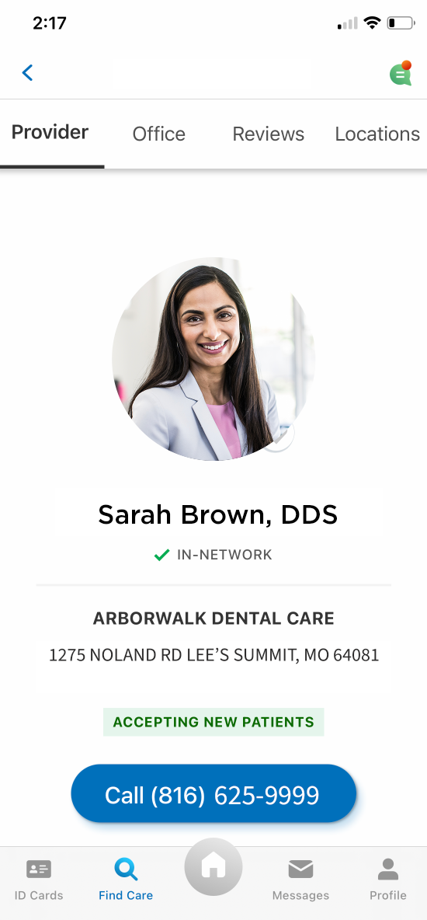
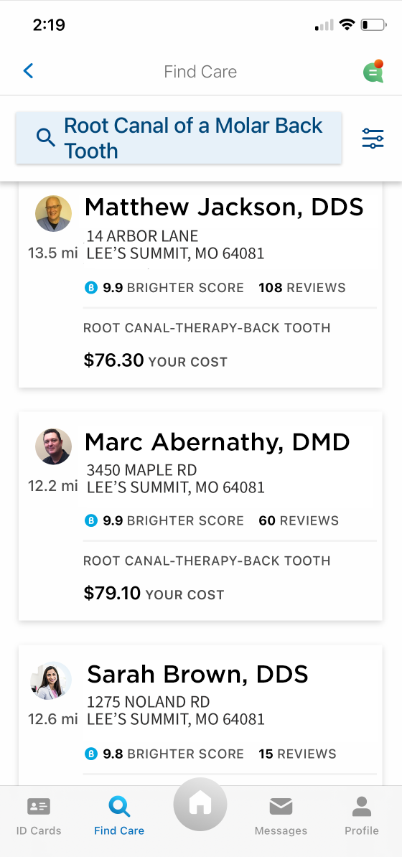
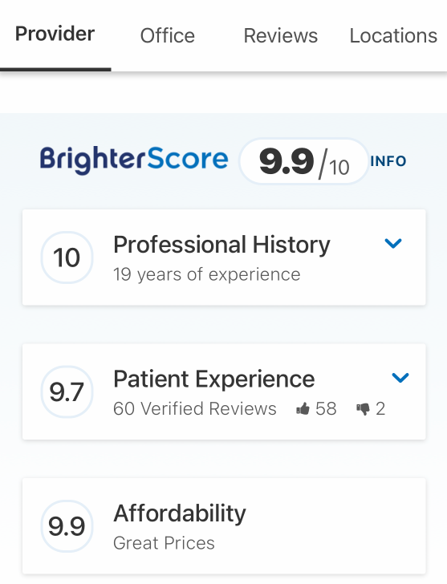
Maximize your plan benefits
myCigna.com
The Brighter Score is an average rating based on patient experience and professional history. Quality designations are not a guarantee of the quality of care that will be delivered to individual patients. Dentists are solely responsible for any treatment provided.
All images used for illustrative purposes.
Notes:
myCigna is available online or through the app. When you activate your account, you’ll get access to plan-specific information that can help you make the most of your plan benefits. You can find network dentists, review costs, view and download claim information (for Basic and Enhanced Plan customers), connect with a licensed dentist through Cigna Dental Virtual Care – and more.

Slide 17

Questions

Slide 18
Dentists who participate in Cigna’s network are independent contractors solely responsible for the treatment provided and are not agents of Cigna. The information in this presentation summarizes the highlights of your plan. For a complete list of both covered and not covered services, including benefits required by your state, see your employer’s plan booklet, evidence of coverage, insurance certificate, or summary plan description – the official plan documents. If there are any differences between the information in this presentation and the plan documents, the information in the plan documents takes precedence.
Product availability may vary by location and plan type and is subject to change. All group dental insurance policies and dental benefit plans contain exclusions and limitations. For costs and details of coverage, review your plan documents or contact a Cigna representative.
All Cigna products and services are provided exclusively by or through operating subsidiaries of Cigna Corporation, including Cigna Health and Life Insurance Company (CHLIC), Cigna Behavioral Health, Inc., Express Scripts, Inc., and HMO or service company subsidiaries of Cigna Health Corporation, including Cigna HealthCare of Arizona, Inc., Cigna HealthCare of California, Inc., Cigna HealthCare of Colorado, Inc., Cigna HealthCare of Connecticut, Inc., Cigna HealthCare of Florida, Inc., Cigna HealthCare of Georgia, Inc., Cigna HealthCare of Illinois, Inc., Cigna HealthCare of Indiana, Inc., Cigna HealthCare of St. Louis, Inc., Cigna HealthCare of North Carolina, Inc., Cigna HealthCare of New Jersey, Inc., Cigna HealthCare of South Carolina, Inc., Cigna HealthCare of Tennessee, Inc. (CHC-TN), and Cigna HealthCare of Texas, Inc. Policy forms: OK - HP-APP-1 et al., OR - HP-POL38 02-13, TN - HP-POL43/HC-CER1V1 et al. (CHLIC); GSA-COVER, et al. (CHC-TN). Cigna Dental Care® (DHMO) plans are insured by Cigna Dental Health Plan of Arizona, Inc., Cigna Dental Health of California, Inc., Cigna Dental Health of Colorado, Inc., Cigna Dental Health of Delaware, Inc., Cigna Dental Health of Florida, Inc., a Prepaid Limited Health Services Organization licensed under Chapter 636, Florida Statutes, Cigna Dental Health of Kansas, Inc. (KS & NE), Cigna Dental Health of Kentucky, Inc. (KY & IL), Cigna Dental Health of Maryland, Inc., Cigna Dental Health of Missouri, Inc., Cigna Dental Health of New Jersey, Inc., Cigna Dental Health of North Carolina, Inc., Cigna Dental Health of Ohio, Inc., Cigna Dental Health of Pennsylvania, Inc., Cigna Dental Health of Texas, Inc., and Cigna Dental Health of Virginia, Inc. CHLIC policy forms: OK – HP-POL99/HP-POL-388, POL115; OR – HP-POL68/HP-POL352, HP-POL121 04-10; TN – HP-POL69/HC-CER2V1/HP-POL389, et al., HP-POL134/HC-CER17V1 et al. In other states, Cigna Dental Care® plans are insured by Cigna Health and Life Insurance Company (CHLIC), or Cigna HealthCare of Connecticut, Inc., and administered by Cigna Dental Health, Inc. Dental PPO plans are insured or administered by CHLIC or Connecticut General Life Insurance Company, with network management services provided by Cigna Dental Health, Inc. and certain of its subsidiaries. In Texas, the insured dental plan is known as Cigna Dental Choice, and this plan uses the national Cigna DPPO network. Policy forms: OK – Dental Indemnity/PPO: HP-POL99 (CHLIC); DHMO: HP-POL115 (CHLIC); OR – Indemnity/DPPO/DEPO: HP-POL68, DHMO: HP-POL121 04-10; TN – Dental Indemnity/PPO: HP-POL69/HC-CER2V1 et al. DHMO: HP-POL134/HC-CER17V1 et al. (CHLIC). The Cigna name, logo, and other Cigna marks are owned by Cigna Intellectual Property, Inc. All pictures are used for illustrative purposes only.
929653 b 07/20 © 2020 Cigna. Some content provided under license.

Slide 19
Appendix A
Cigna Dental Care® for residents of Minnesota and Oklahoma
Minnesota Residents: When enrolling in a Cigna Dental Care® plan, you must visit your selected network dentist in order for the charges on the Patient Charge Schedule to apply. You may also visit other dentists that participate in our network or you may visit dentists outside the Cigna Dental Care® network. If you do, the fees listed on the Patient Charge Schedule will not apply. You will be responsible for the dentist’s usual fee. We will pay 50% of the value of your network benefit for those services. You’ll pay less if you visit your selected Cigna Dental Care® network dentist. Call customer service for more information.
Oklahoma Residents: Cigna Dental Care® for Oklahoma is an Employer Group Prepaid Dental Plan. You may also visit dentists outside the Cigna Dental Care® network. If you do, the fees listed on the Patient Charge Schedule will not apply. You will be responsible for the dentist’s usual fee. We pay non-network dentists the same amount we’d pay network dentists for covered services. You’ll pay less if you visit a network dentist in the Cigna Dental Care® network. Call customer service for more information.

Slide 20
Appendix B
DPPO limitations and exclusions
The following limitations apply to most DPPO plans: Two (2) cleanings per calendar year, one (1) bitewing x-ray per calendar year, one (1) full mouth x-ray every five calendar years, and one (1) panorex x-ray every five calendar years; crowns and inlays replacement of crowns and inlays is limited to once every five years; prosthesis over implants is limited to one (1) every five years if unserviceable and cannot be repaired; replacement of bridges is limited to once every five years; replacement of dentures and partials is limited to once every seven years; coverage for sealants is limited to posterior tooth, with one (1) treatment per tooth every three years up to a maximum age of 16; space maintainers are limited to non-orthodontic treatment.
The following are generally not covered unless included in your specific dental plan or required by law.
Services that are not medically necessary;
Experimental dentistry, cosmetic dentistry, or any services that do not meet common dental standards;
Replacement of a bridge or denture which can be made usable according to accepted dental standards;
Procedures, appliances or restorations, other than full dentures, whose main purpose is to change vertical dimension, diagnose or treat conditions of TMJ, stabilize periodontally involved teeth, or restore occlusion;
Veneers of porcelain or acrylic materials on crowns or pontics on or replacing the upper and lower first, second and third molars;
Bite registrations; precision or semi-precision attachments; splinting;
Surgical implant of any type; and
Charges for unnecessary care, treatment or surgery, or charges in excess of the reasonable and customary allowances.
Depending on your plan, the replacement of teeth that are missing prior to your effective date of coverage may not be covered. This is not a complete list and the terms of your specific dental plan may vary. Waiting periods may apply. See your plan documents for a complete list of plan terms, conditions, exclusions and limitations.

