Slide 1

2022-2023
Prescription Benefits
State of Connecticut
Florence Belcher
  Senior Account Manager
    April 2022

Slide 2
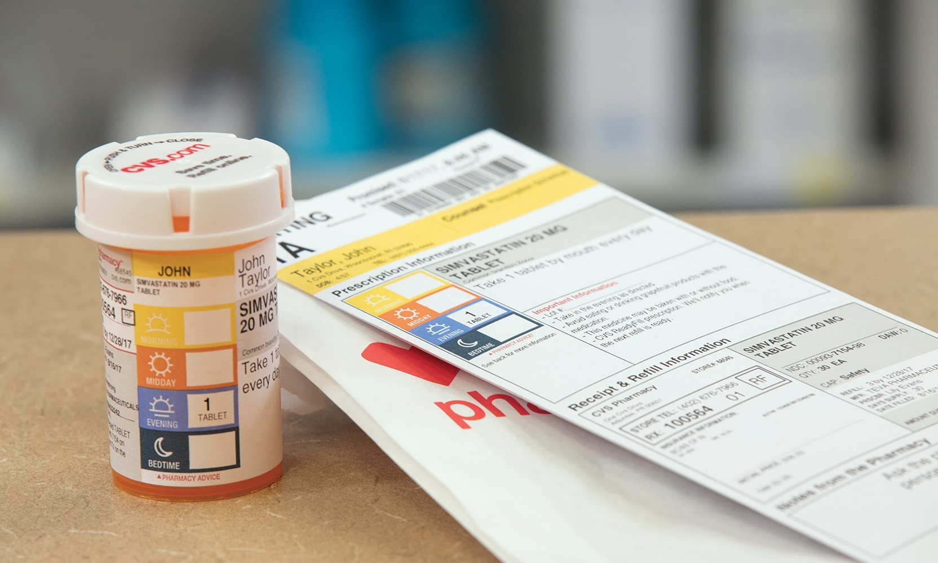
Maintenance Choice
2022-2023 Prescription Benefits
With Maintenance Choice, medications you take regularly (such as diabetes, asthma or high blood pressure medications) must be filled in 90-day supplies at CVS Pharmacy or through CVS Caremark Mail Service Pharmacy or through any pharmacy that participates in the State of Connecticut Maintenance Drug Network.
You can choose pickup or Rx delivery by mail – either way, the cost is the same
One 30-day fill required at any retail pharmacy before filling a 90-Day supply.
To check the participating pharmacies included in the State of Connecticut Maintenance Drug Network, please visit carecompass.ct.gov/state/pharmacy
Need to transfer your prescription?
Visit Caremark.com/MoveMyMeds
2
©2020 CVS Health and/or one of its affiliates. Confidential and proprietary.
52474C
Image source: CVS Health Creative Resource Library, accessed 2020. Rx_bag_and_bottle_on_counter_075. Asset ID: 203603. No expiration.

Slide 3
Non-Maintenance Medications
2022-2023 Prescription Benefits
Fill 30-day prescriptions at more than 68,000 participating retail pharmacies nationwide.
These include your one-time fill medications. Such as Antibiotics and Pain Medication.
3
©2020 CVS Health and/or one of its affiliates. Confidential and proprietary.
52474C
Image source: CVS Health Creative Resource Library, accessed 2020. Rx_bag_and_bottle_on_counter_075. Asset ID: 203603. No expiration.
Notes:
Your plan offers the Retail 90 network, which lets you fill prescriptions for medications you take regularly – like diabetes, asthma, or high blood pressure medications – in convenient 90-day supplies. Sign in to Caremark.com to find a Retail 90 pharmacy.
Image source: CVS Health Creative Resource Library, accessed 2020. Rx_bag_and_bottle_on_counter_075. Asset ID: 203603. No expiration.

Slide 4
Prescription Drugs | Non-Maintenance (up to a 30-Day supply) | Maintenance (90-Day supply) | Diabetes Maintenance Medications (90-Day supply) | HEP Chronic Conditions
Generic | $5 for lower cost generic Prescriptions $10 for higher cost generic prescriptions | $5 for lower cost generic Prescriptions $10 for higher cost generic prescriptions | $0 | $0
Preferred Brands | $25 | $25 | $0 | $5
Non-Preferred Brands | $40 | $40 | $0 | $12.50
Maximum out-of-pocket | $4,600 per individual, $9,200 per family

Slide 5
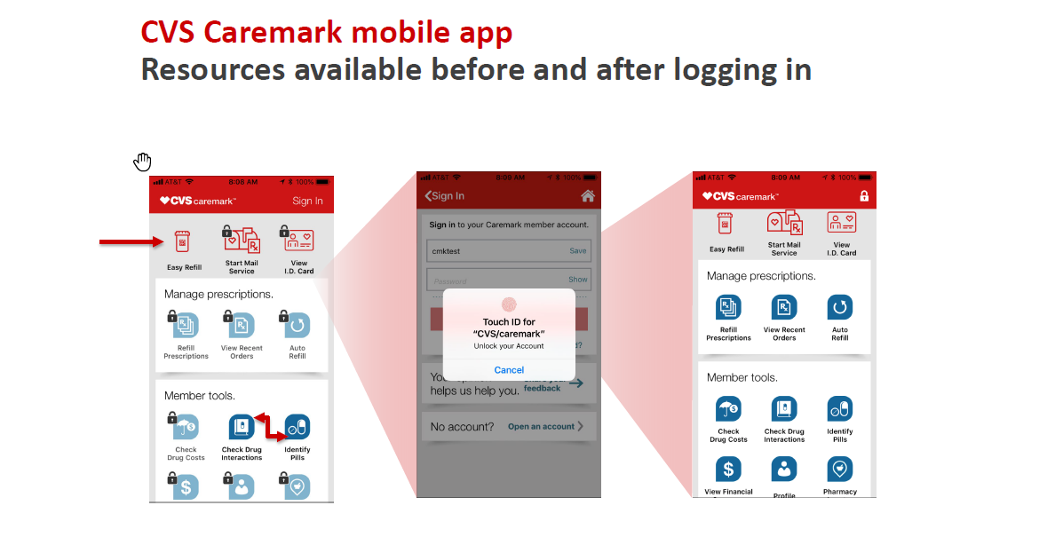

Slide 6
