Slide 1


Slide 2


Slide 3
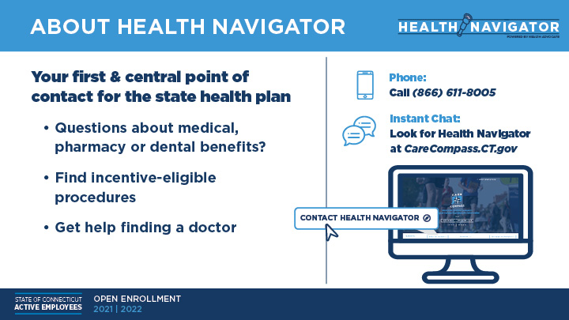

Slide 4
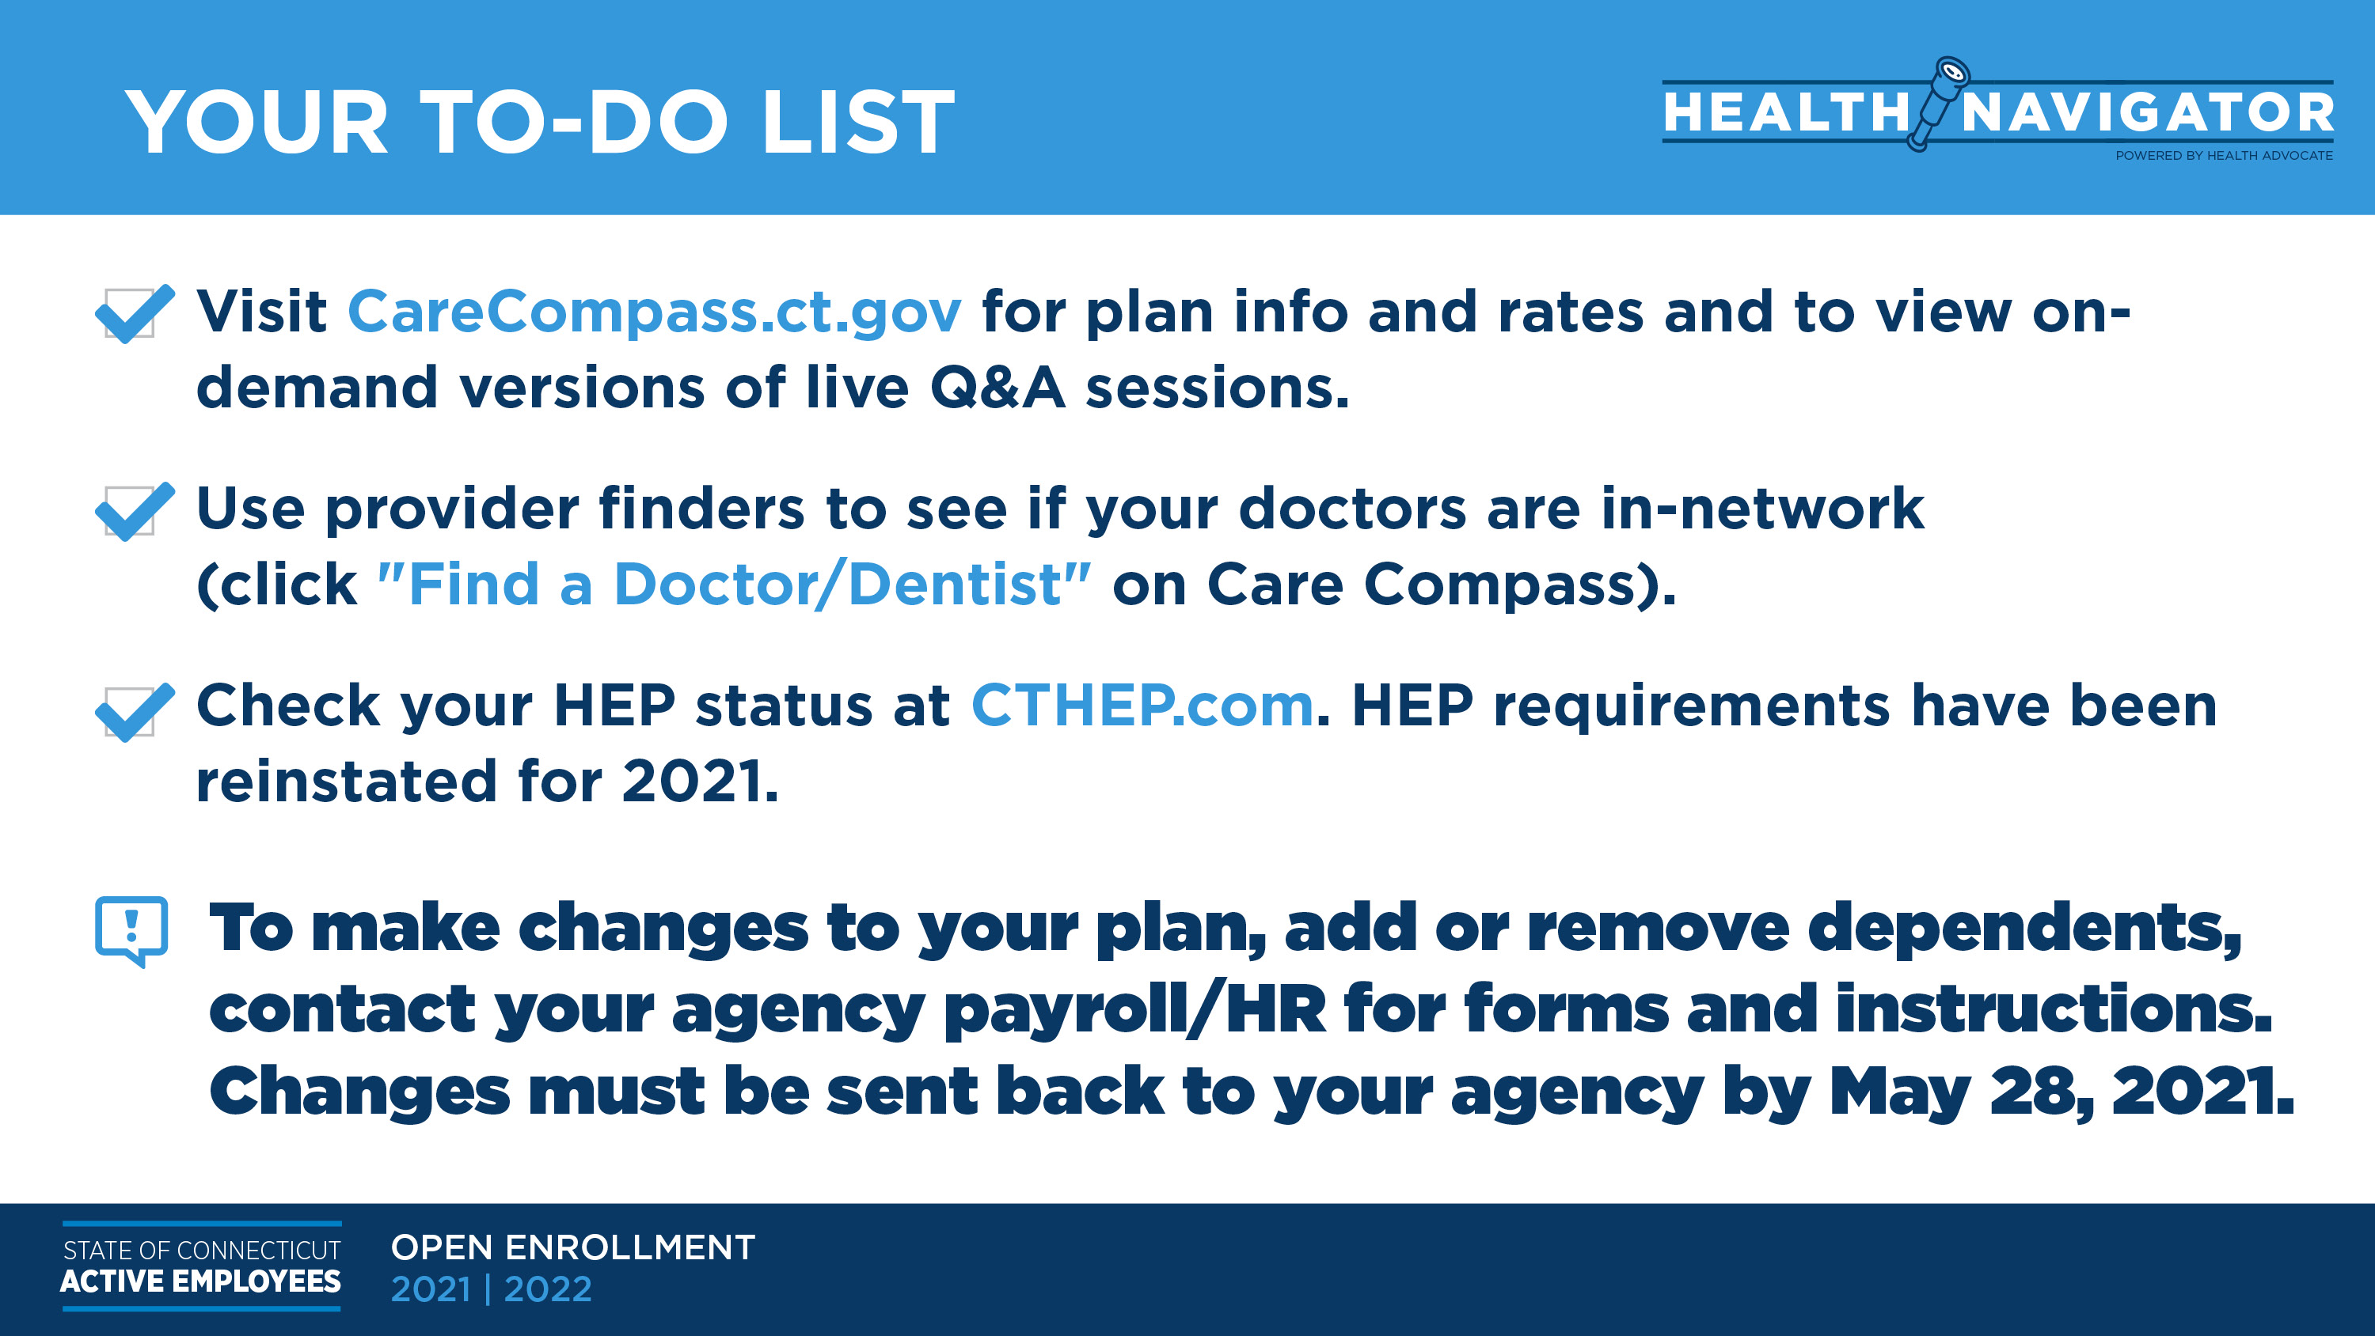

Slide 5

ONE NUMBER, COMPLETE SUPPORT
Health Navigator
Provided by the state at no cost to you!
Central point of contact for all of your healthcare and benefits needs
Confidential support from a Personal Health Navigator
Interactive website and mobile app
Unlimited access for you, your spouse, dependent children, parents and parents-in-law

Slide 6
SAVE TIME, MONEY AND WORRY
A Personal Health Navigator can:
Locate doctors, hospitals and other healthcare facilities that offer high quality care and service, including Networks of Distinction
Explain the cost savings and benefits of staying in-network
Schedule appointments and transfer medical records
Provide expert help with medical issues, no matter how complex
Coordinate services related to all aspects of your care
Resolve insurance claims and medical billing issues

Slide 7


PERSONALIZED ASSISTANCE AT YOUR FINGERTIPS
Health Navigator Website and Mobile App
Instantly connect with a Personal Health Navigator
Use the Health Navigator Search Tool to find Networks of Distinction and view available incentives
Upload documents and forms
View the status of a case in real time
Review trusted information on health topics
Download the app or visit: healthadvocate.com/stateofconnecticut
TO REGISTER ON THE WEBSITE:
Click “Register Now”
Enter your personal information
Create a username and password; select security questions
Confirm you read the Privacy Statement and Terms and Conditions
Click register
Verify your email address

Slide 8


FIND NETWORKS OF DISTINCTION & AVAILABLE INCENTIVES
Network of Distinction providers and locations offer the highest quality care. Visiting one for certain procedures may earn you a cash incentive. Here’s how to find one:
Log into the Health Advocate website or app
From the “I would like to…” menu on the home page, select Health Navigator
Input your search criteria into the fields
Click “Submit”
View your results

Slide 9


GET STARTED TODAY
Call 866.611.8005 or visit HealthAdvocate.com/StateofConnecticut
and we will get you the help you need!

